Slide 1

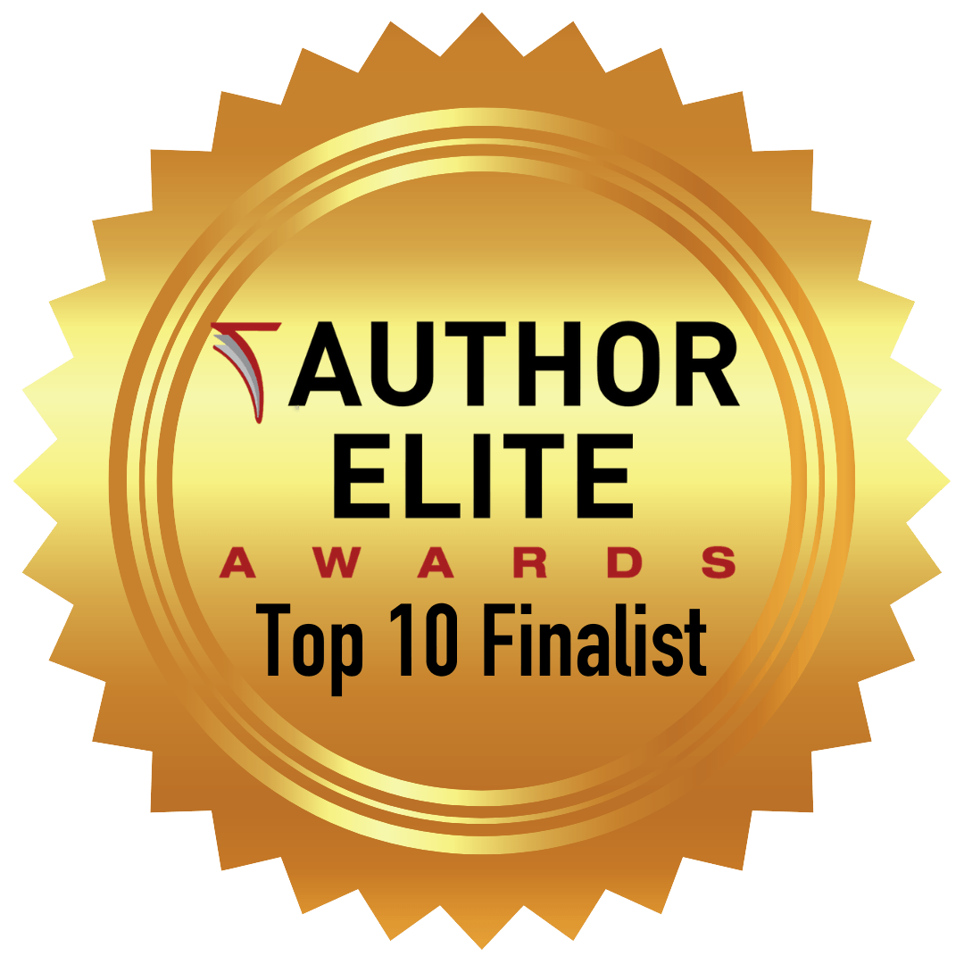
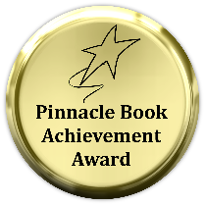
Using a Hybrid Publisher
June 2022 – presentation to the Gulf Coast Writer’s Association by Dr. Susan K. Grunin – Award Winning author of Life Lessons and Tales of Little MisFit – Book 1: Life Isn’t Always What It Seems

Slide 2
What Is a Hybrid Publishing Company?
“Hybrid” means different things to different people.
Interchangeable with vanity publishing —publishes anything that authors ask to be published.
A true hybrid combines elements of traditional publishing and self-publishing.

Slide 3
Vanity vs Hybrid: What’s the difference?
Functionally, the difference between the business models of vanity and hybrid publishers comes down to their scruples.
The ideal hybrid publisher is:
Selective when it comes to the authors they work with
Will truly want to help shape and market the books they take on
Have an editorial board which reviews and then accepts and/or and this is KEY – REJECTS manuscripts to be published. Most review processes take 6-8 weeks.

Slide 4
Vanity vs Hybrid: What’s the difference?
Whereas, a vanity publisher will publish ANY manuscript that is submitted to them (of course for a charge)
Encourage the author to pay for add-ons and extra costs that will supposedly boost the author’s book's success.
If they’re particularly odious, they will also hold the author’s intellectual property ransom down the line.

Slide 5
Key to Understanding Differences between a Hybrid Publisher and a Vanity Press
3 categories or models of hybrid publishers, but the best of them have one thing in common: they maintain high standards — not only with producing and marketing books, but editorially as well.
Remember -if they are willing to publish almost any author that is willing to pay them, then they’re not a hybrid publisher anymore — they’re a vanity press.

Slide 6
True Hybrid Publishers
Function mostly like a traditional publisher, have an editorial board of review and REJECT manuscripts that do not meet set criteria.
The key exception - authors will subsidize the cost of publishing and will not be given an advance on royalties- but will receive a higher percentage of royalties than given by traditional publishers.

Slide 7
Three Models of Hybrid Publishers
The partnership model - most akin to traditional publishing with this model the editorial review process must first accept the manuscript. If the manuscript is accepted, then they will offer the author a partnership contract and shepherd the book through every step of the publication process from editing to marketing.
Two crucial differences from traditional publishing: 1) the author fronts much of their book’s production costs and 2) won't receive an advance, but will earn a greater share of the royalties

Slide 8
2. The Crowdfunding Model
Authors interested in using the crowdfunding model need to raise funds to produce their book by appealing to the crowd. This signals that their book is a good bet — after all, there’s already a readership willing to put money down for it.
There is, of course, a catch: if the author doesn't raise a certain minimum dollar amount, the book is subject to cancellation.

Slide 9
3. The Agent-assisted Model
Sometimes, literary agents get manuscripts that they know will be a tough sell to the major commercial presses — they might be beautifully written, but just a touch too quirky for mainstream success.
In these cases the agent will produce the book themselves, leveraging their knowledge of the publishing industry’s best practices. They'll also try to sell the foreign rights to the book.

Slide 10
Ways to Tell if a Hybrid Publisher Is Legit
Most “hybrid publishers” are actually vanity presses
However a few publishers which charge fees for editing, designing, and marketing the book AND are also invested in its commercial success are legitimate hybrid publishers. It can be difficult to tell them apart in a sea of vanity presses.
Generally they pay higher royalties than the traditional publisher but do not offer upfront payments and don’t just profit from the fees collected alone.

Slide 11
Ways to Tell if a Hybrid Publisher Is Legit
Know also that the hybrid publishing model, though it isn’t outright predatory, means that you will have to shoulder much of the financial risks of putting your book out there.
A hybrid publisher doesn’t have the resources that a traditional publisher has; and those limited resources have to be shared between several authors.

Slide 12
8 Signs Your Publisher is a Scam
THEY:
1) Charge Reading Fees. ...
2) Guarantee Bestsellers… and Tell You Your Book's Perfect.
3) Don’t Have an Editorial Board/Review of Manuscripts Process in Place …
4) Are Faceless. ...
5) Nickel and Dime You. ...
6) Claim to be a Self-Publisher or Independent, But Have a Royalty Structure in Place.
7) Try to Claim Your Rights/Sub-Rights. ...
8) Have a Minimal Presence on the web.

Slide 13
Some Vanity Presses Are Owned by Major Publishers and Do Not Get Books into Bookstores
To make things even more complicated, some of the world's most prolific vanity presses are actually owned by Big 5 publishers. Xlibris and Author Solutions (which some consider shady companies) are both subsidiaries of Penguin Random House.

Slide 14
Some Vanity Presses Are Owned by Major Publishers and Do Not Get Books into Bookstores
Though a common promise to distribute to major bookstores most of these vanity presses do not.
Traditional publishers have sales representatives with the negotiation skills, reputation, and connections needed to get your book to big chains; the same can’t be said for vanity presses but legit hybrids do get your book on Amazon and in Barnes and Noble and in other distribution sites as well.

Slide 15
Some Vanity Presses Are Owned by Major Publishers and Do Not Get Books into Bookstores
Instead, vanity presses will probably ONLY list your book on a distribution service like Ingram.
This listing makes it possible for a wide range of brick-and-mortar shops to order your book, but it doesn’t guarantee actual orders. Whether you get your book into stores depends on the ties you can establish with booksellers and readers. If a lot of readers ask for your book at an independent bookshop, the seller is likely to order the title.

Slide 16
What Should You Look for in a Hybrid Publisher?
As a rule of thumb, when you see the “hybrid publisher” label, you should immediately be wary. Be sure to carefully research the company — use the standards listed below on how to recognize a legitimate hybrid publisher that can take you through that vetting process.
In 2018, the Independent Book Publishers Association published their criteria for defining a reputable hybrid publisher — a set of standards any author can use to vet the companies on their shortlist. According to the IBPA’s criteria, a hybrid publisher must:

Slide 17
What Should You Look for in a Hybrid Publisher? (continued)
Define a mission and vision for its publishing program. Translation: their selection criteria has to have some rhyme or reason beyond just “the author was willing to pay us.”
Vet submissions. Translation: same as above — they can’t just be willing to publish anything that lands on their desk.

Slide 18
What Should You Look for in a Hybrid Publisher? (continued)
Publish under its own imprint(s) and ISBNs. Translation: they can’t hide their back catalog from future authors.
Publish to industry standards.
Translation: if their books are missing copyright pages and the layouts are unlike any book you’ve ever read… then you’re not dealing with a requtable hybrid.

Slide 19
What Should You Look for in a Hybrid Publisher? (continued)
Ensure editorial, design, & production quality. Translation: no cutting corners on editorial or design work. If their books have awful covers and typo-ridden copy, then beware!
Pursue and manage a range of publishing rights. Translation: they should have a vested interest in the success of your book — not just publish it and forget it.

Slide 20
What Should You Look for in a Hybrid Publisher? (continued)
Demonstrate respectable sales. Translation: if they’ve never managed to sell anyone else’s book, what makes you think yours will be any different?
Pay authors a higher-than-standard royalty. Translation: if you, the author, are going to invest in the publication of your book, you better get a bigger cut of the proceeds than a traditionally published author would. Authors also retain the rights to the books and content.

Slide 21
What Should You Look for in a Hybrid Publisher? (continued)
Provide distribution services. Translation: they can’t just make your book available for bookshops to buy (any self-publishing author can do that). They need to actively work to place your book with retailers.

Slide 22
What Type of Book/Author Is Most Likely to Benefit from Using a Hybrid Publisher?
Author’s who:
have a large number of illustrations to be drawn or inserted in a book. This could be a children’s book or a non-fiction book or a picture book or other that requires special skills of an illustrator or a graphic designer.
have tried to get an agent and didn’t succeed and don’t want to secure all of the resources themselves from FIVVR or other sources to edit, format, illustrate, and get their book published on Amazon and in Barnes and Noble etc.

Slide 23
Services Available from a Hybrid Publisher
If you don’t publish with a traditional publisher and you don’t want to self-publish then you might look at a Hybrid Publisher.
Here are some of the services available from legit hybrid publishers: editing, special formatting – important for children’s books, building websites and trailers, marketing, distribution to Amazon and other bookstores such as Barnes and Noble and distribution centers.
You choose which services – except for editing – this requirement is part of the contract costs.

Slide 24
Deciding Whether to Use a Hybrid Publisher – It Isn’t for Everyone!
If you don’t publish with a traditional publisher and you cannot determine if a publisher is a legit hybrid, it may be safer to collaborate with qualified professional editors, cover designers, and marketers with experience in your niche to self-publish your book.
They will be able to dedicate time and effort specifically to your project and give you the best chance of success.

Slide 25
USE GCWA Sources and Resources!
Being a member of GCWA can provide you with sources and resources that many wanna-be authors do not have access to.

Slide 26
Deciding Whether to Use a Hybrid Publisher – It Isn’t for Everyone!
Follow the criteria of what to look for in a Hybrid Publisher.
Look at a hybrid publisher such as Austin McCauley's London and/or New York Websites and see if they are a member of the IBPA for US legitimate hybrid publishers. Austin Macauley Publishers is a member of The Publishers Association (UK) and IBPA (US).

Slide 27
Deciding Whether to Use a Hybrid Publisher – It Isn’t for Everyone!
Check to see that the Publisher is a member of the IBPA; This makes it a reputable hybrid publisher in US.
Note: Every manuscript submitted to Austin Macauley is tested for its merits and is seen from the perspective of offering a traditional contract first – if you have already been a published author.

Slide 28
For some Help in Deciding Whether to Use a Hybrid Publisher
Check out my author’s page (note SK Grunin’s book 2 – Life Lessons and Tales of Little MisFit - Life Isn’t Always Fair - will be published in 2022) on their website: https://www.austinmacauley.com/book/life-lessons-and-tales-little-misfit and check out my website: www.skgCreations.com (built by our own webmaster – Judy Loose)
Email me if you have questions: skgrunin@yahoo.com

